Slide 1
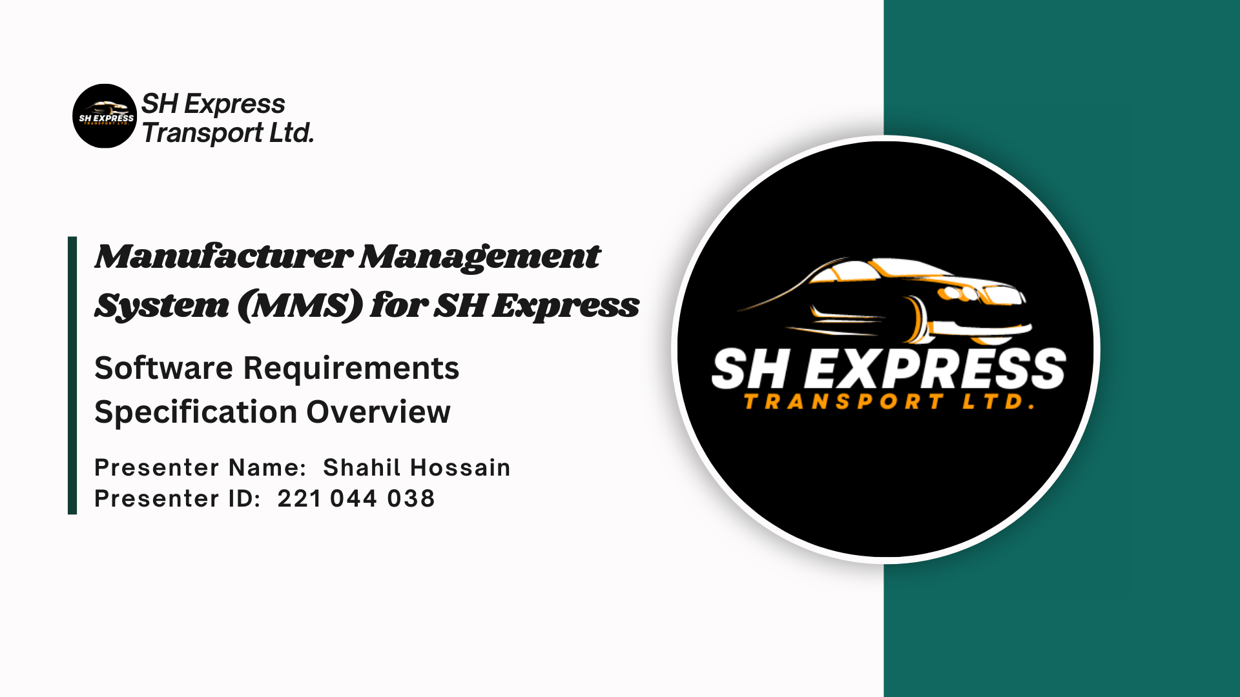


Slide 2
Introduction
Purpose:
Overview of the Manufacturer Management System (MMS) for SH Express.
Enhancing manufacturing operations from raw material procurement to final product delivery.
Scope:
Managing the lifecycle of manufacturing, including procurement, inventory, production, and distribution.
Objective:
Optimize efficiency, reduce costs, and improve operational control.

Slide 3
System Overview - Product Perspective & Functions
Product Perspective:
MMS as a standalone, integrated with existing systems.
Centralizes manufacturing operations.
Key Functions:
Procurement Management: Efficient sourcing of aluminum, iron, plastic, leather.
Inventory Management: Real-time tracking of raw materials and finished products.
Production Planning: Automated scheduling and resource allocation.
Quality Control: Ensures all products meet standards.
Logistics & Distribution: Manages the distribution of finished buses.

Slide 4
System Overview - Users & Environment
User Roles:
Procurement Officers: Manage material sourcing.
Inventory Managers: Track and manage inventory levels.
Production Managers: Oversee the manufacturing process.
Quality Assurance Teams: Ensure product quality.
Logistics Coordinators: Handle product distribution.
Operating Environment:
Accessible via desktop and mobile devices.
Integrates with SH Express’s existing IT infrastructure.

Slide 5
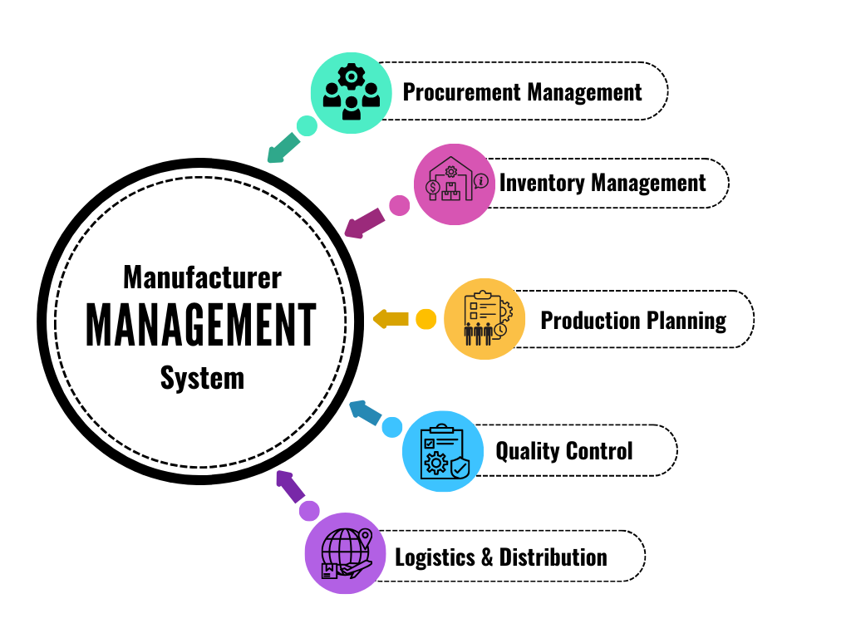

Slide 6
Procurement Management
The system must handle the procurement of raw materials like aluminum, iron, plastic, and leather. It will automate the process of sending purchase orders to suppliers, tracking material delivery, and ensuring adequate stock levels for production.
System Functions:
Ability to create, manage, and track purchase orders.
Supplier management, including integration with existing suppliers’ systems.
Real-time updates on material status (available, in-transit, delayed).
Notification of low stock levels for critical materials.

Slide 7
Inventory Management
The MMS should provide real-time visibility into the inventory of raw materials and finished goods, ensuring materials are available for production when needed. It should track material usage and generate alerts for reordering.
System Functions:
Automated tracking of raw materials and finished goods.
Real-time updates on stock levels, including reorder alerts.
Categorization of materials by type (aluminum, iron, plastic, etc.).
Integration with procurement and production planning to maintain optimal stock levels.

Slide 8
Production Planning and Scheduling
The MMS must facilitate production planning and scheduling by coordinating resources (raw materials, machinery, and labor) to ensure production meets demand efficiently. The system should allow for the creation of production orders and schedules.
System Functions:
Creation and management of production orders based on customer demand.
Scheduling of production jobs, optimizing machinery and resource allocation.
Integration with inventory management to ensure required raw materials are available before production starts.
Real-time monitoring of production status, including delays or issues.

Slide 9
Quality Control
The system should ensure that all products meet quality standards. It should track quality control measures at various stages of production and enable corrective actions if quality issues arise.
System Functions:
Integration of quality control checks at key production stages.
Logging and reporting of quality test results.
Notifications and alerts if a product fails a quality check.
Ability to track defects and take corrective actions in the production workflow.

Slide 10
Logistics and Distribution
The MMS must manage the logistics of delivering finished products to customers, ensuring timely dispatch and delivery. It should integrate with third-party logistics providers and track shipments.
System Functions:
Management of order shipments, including tracking and delivery scheduling.
Integration with third-party logistics systems for real-time shipment tracking.
Route optimization for product delivery, minimizing costs and delays.
Notifications for shipment dispatch, delays, or delivery completion.

Slide 11
How These Functional Requirements Connect to the Manufacturer Management System (MMS):
The Procurement Management ensures raw materials are ordered and available for production in a timely manner, minimizing production delays due to stockouts.
Inventory Management works in real-time with procurement and production, giving insights into stock levels and preventing shortages.
Production Planning and Scheduling ensures that resources, including materials and labor, are optimally utilized to meet production targets, keeping operations running smoothly.
Quality Control integrates into every stage of production, ensuring that SH Express maintains its high standards for bus manufacturing.
Logistics and Distribution manage the dispatch and delivery of completed buses, ensuring products reach customers on time and are traceable throughout the supply chain.

Slide 12
Diagram
User
Order
Production Order
Supplier
Raw Material
Inventory
Report

Slide 13
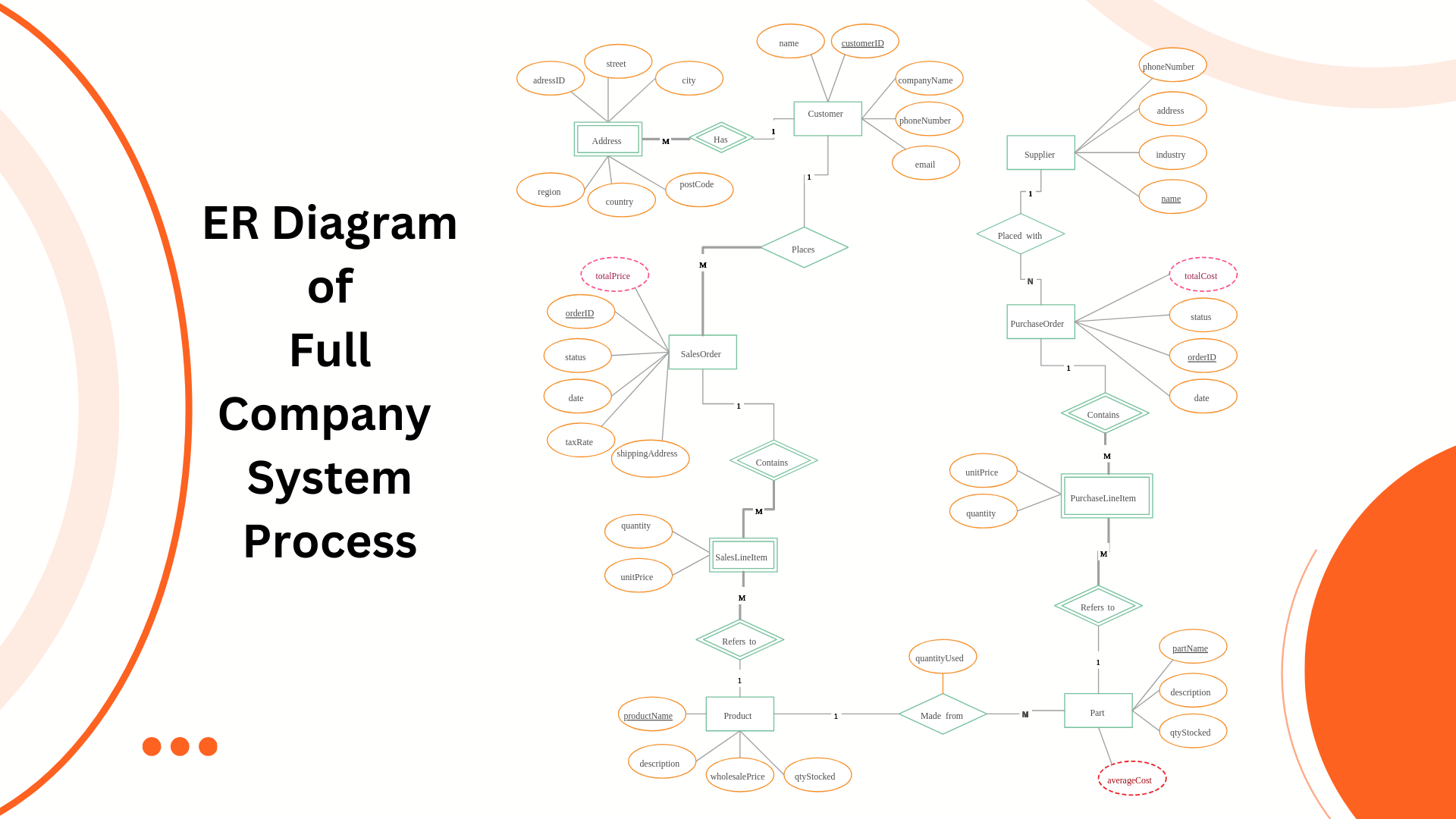

Slide 14
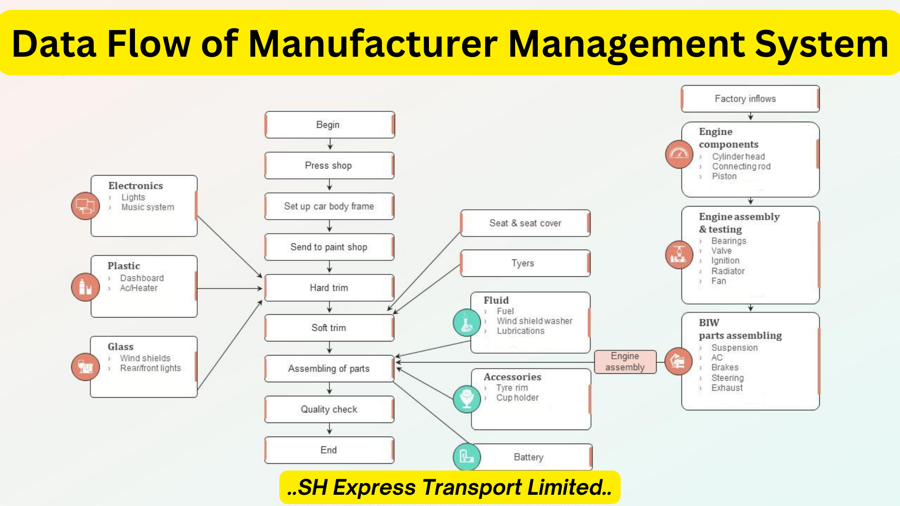

Slide 15
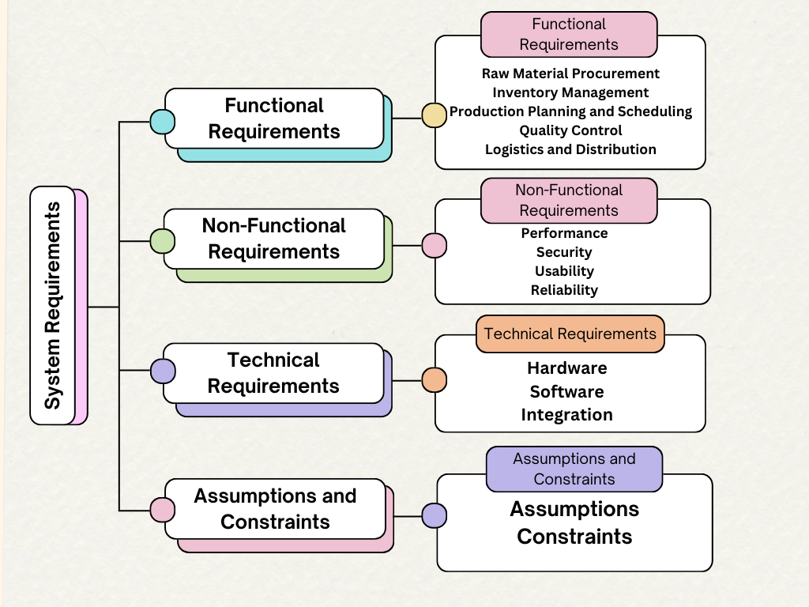

Slide 16
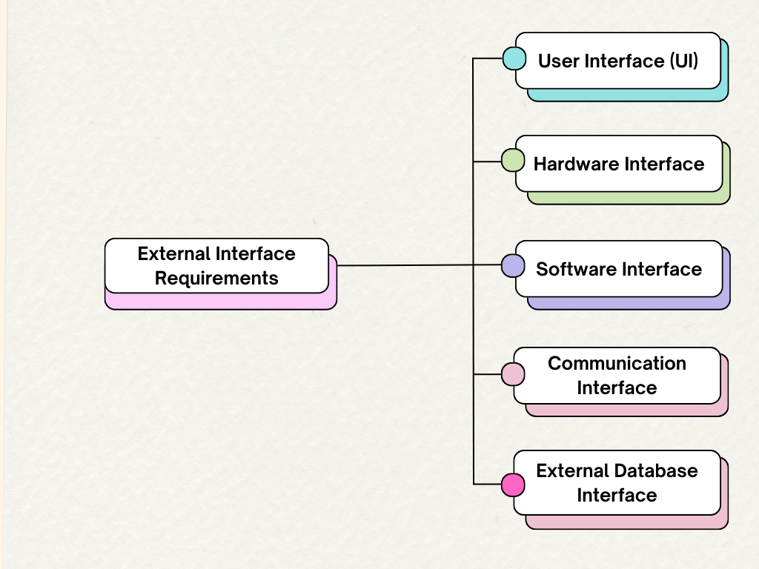
External Interface Requirements
User Interfaces: The interface for system operators, management, and customers.
Hardware Interfaces: Interaction with manufacturing hardware, such as machines or assembly lines
Software Interfaces: Integration with other systems like ERP, CRM, and supplier databases.
Communication Interfaces: API and data exchange protocols for suppliers and logistics.
External Database Interface: Exchanges Third-Party Databases & Cloud Storage Services.

Slide 17
System Features
Inventory Management: Real-time tracking of raw materials and finished products.
Production Management: Automated scheduling and workflow optimization.
Quality Control: Quality Inspection and Defect Tracking optimization.
Supplier Management: Handle supplier relations, materials acquisition.
Order Management: Manage orders from placement to delivery.
Reporting and Analytics: Data-driven insights for decision-making.

Slide 18
System Architecture
Client-Server Architecture: Separation of user interface, business logic, and database layers.
Database Layer: Centralized relational database for storing data.
Application Layer: Handles business logic for production and inventory.
User Interface Layer: Accessible through web or mobile applications.

Slide 19
Validation and Verification
Requirements Validation: Ensuring the system meets SH Express's requirements.
User Acceptance Testing (UAT): Users confirm system functionality in real-world scenarios.
Functional and Performance Testing: Ensuring system reliability and efficiency.
Security Testing: Testing security measures to prevent unauthorized access.

Slide 20
Documentation Requirements
User Documentation: User manuals, quick reference guides for users.
Technical Documentation: System architecture documents, API references.
Maintenance Documentation: Admin guides and troubleshooting manuals.
Training Manuals: For system administrators and end users

Slide 21
Appendices
Glossary: Definitions of technical terms and acronyms used.
Data Dictionary: List of data fields used in the system.
Workflow Diagrams: Visual representation of key workflows like order processing.
Compliance Information: Regulatory guidelines that the system follows.

Slide 22
Glossary
MMS: Manufacturer Management System.
UAT: User Acceptance Testing.
API: Application Programming Interface.
CRM: Customer Relationship Management.

Slide 23
..Thank you..
..Stay Away, Stay Safe..

